Slide 1
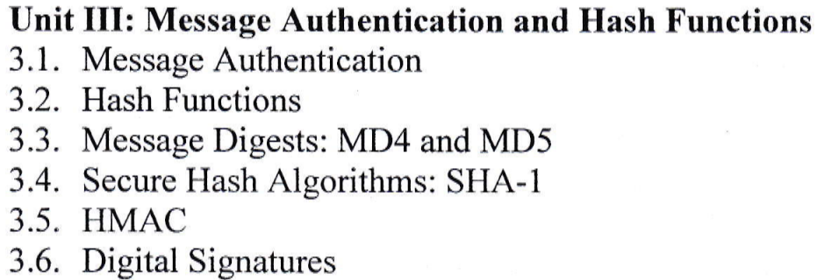

Slide 2
Message Authentication
Message authentication allows one party—the sender—to send a message to another party—the receiver—in such a way that if the message is modified en route, then the receiver will almost certainly detect this.
Message authentication is also called data-origin authentication.
Message authentication is said to protect the integrity of a message, ensuring that each message that it is received and deemed acceptable is arriving in the same condition that it was sent out—with no bits inserted, missing, or modified.
Message authentication provides two services. It provides a way to ensure message integrity and a way to verify who sent the message.

Slide 3
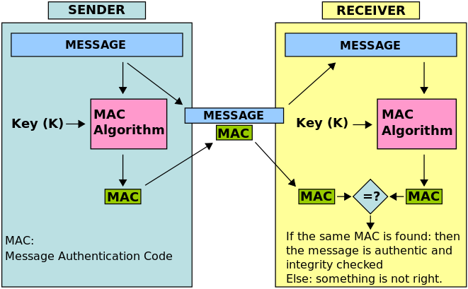
How Message Authentication Works?

Slide 4
Message Authentication Functions:
The message authentication function is concerned with the types of functions that may be used to produce an authenticator. These may be grouped into three classes:
• Hash function: A function that maps a message of any length into a fixed- length hash value, which serves as the authenticator. • Message encryption: The ciphertext of the entire message serves as its authenticator. • Message authentication code (MAC): A function of the message and a secret key that produces a fixed-length value that serves as the authenticator.

Slide 5
Message Authentication Functions:
1. Hash Function
Description: A hash function maps a message of any length into a fixed-length hash value.
Purpose: The hash value serves as the authenticator for the message.
Example: SHA-256 is a widely used cryptographic hash function.
How it works: The sender computes the hash value of the message and sends it along with the message. The recipient computes the hash value of the received message and compares it with the received hash value to verify integrity.

Slide 6
2. Message Encryption
Description: The ciphertext of the entire message serves as its authenticator.
Purpose: Encryption ensures that only the intended recipient, who has the correct decryption key, can read the message and verify its authenticity.
Example: AES (Advanced Encryption Standard) is a common encryption algorithm.
How it works: The sender encrypts the entire message using a secret key and sends the ciphertext. The recipient decrypts the ciphertext using the same secret key to verify the message.

Slide 7
3. Message Authentication Code (MAC)
Description: A MAC is a function of the message and a secret key that produces a fixed-length value.
Purpose: The MAC value serves as the authenticator for the message, ensuring both integrity and authenticity.
Example: HMAC (Hash-based Message Authentication Code) uses a cryptographic hash function and a secret key.
How it works: The sender generates the MAC using the message and a secret key and sends the MAC along with the message. The recipient generates the MAC for the received message using the same secret key and compares it with the received MAC to verify the message.

Slide 8
Message Authentication Code (MAC)
A message authentication code (MAC) is a cryptographic checksum on data that uses a session key to detect both accidental and intentional modifications of the data.
It is a security code that is typed in by the user of a computer to access accounts or portals. This code is attached to the message or request sent by the user.
Message authentication codes (MACs) attached to the message must be recognized by the receiving system in order to grant the user access.
MACs are commonly used in electronic funds transfers (EFTs) to maintain information integrity.

Slide 9
Message Authentication Code (MAC) Work Flow
The message authentication code technique involves the use of a secret key to generate a small block of data that is appended to the message.
This technique assumes that two communicating parties, say A and B, share a common secret key K_{AB}.
When A has a message to send to B, it calculates the message authentication code as a function of the message and the key:
MAC_{M} = F (K_{AB},M).
The message plus code are transmitted to the intended recipient. The recipient performs the same calculation on the received message, using the same secret key, to generate a new message authentication code.
The received code is compared to the calculated code.

Slide 10
Message Authenticate Code (MAC) Work Flow
If we assume that only the receiver and the sender know the identity of the key, and if the received code matches the calculate code, then
The receiver is assured that the message has not been altered.
The receiver is assured that the message is from the alleged sender. Because no one else knows the secret key, no one else could prepare a message with a proper code.
If the message includes a sequence number, then the receiver can be assured of the proper sequence, because an attacker cannot successfully alter the sequence number.

Slide 11
3.2 Hash Functions
A hash function takes a group of characters (called a key) and maps it to a value of a certain length (called a hash value or hash).
The hash value is representative of the original string of characters, but is normally smaller than the original.
Hashing is used in encryption and also done for indexing and locating items in databases.
A hash function maps keys to small integers (buckets). An ideal hash function maps the keys to the integers in a random-like manner, so that bucket values are evenly distributed even if there are regularities in the input data. This process can be divided into two steps as:
a) Map the key to an integer.
b) Map the integer to a bucket.
Note: The input to the hash function is of arbitrary length but output is always of fixed length.

Slide 12
3.2 Hash Functions
Features
Fixed Length Output (Hash Value)
Hash function coverts data of arbitrary length to a fixed length. This process is often referred to as hashing the data.
In general, the hash is much smaller than the input data, hence hash functions are sometimes called compression functions.
Since a hash is a smaller representation of a larger data, it is also referred to as a digest.
Hash function with n bit output is referred to as an n-bit hash function. Popular hash functions generate values between 160 and 512 bits.
b) Efficiency of Operation
Faster than a symmetric operation

Slide 13
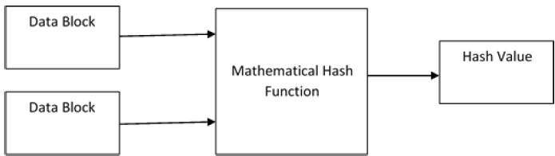
Design of Hashing Algorithms
Hashing is a mathematical function that operates on two fixed-size blocks of data to create a hash code. This hash function forms the part of the hashing algorithm.
The size of each data block varies depending on the algorithm. Typically the block sizes are from 128 bits to 512 bits. The following illustration demonstrates hash function −

Slide 14
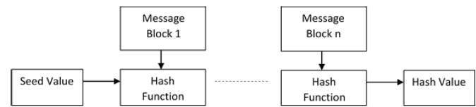
Design of Hashing Algorithms
Hashing algorithm involves rounds of above hash function like a block cipher. Each round takes an input of a fixed size, typically a combination of the most recent message block and the output of the last round.
This process is repeated for as many rounds as are required to hash the entire message. Schematic of hashing algorithm is depicted in the following illustration
The hash value of first message block becomes an input to the second hash operation, output of which alters the result of the third operation, and so on. This effect, known as an avalanche effect of hashing.

Slide 15
Applications of Hash Functions
Password Storage – provide protection to storage of password
Data Integrity Check – to check correctness of data

Slide 16
3.3 Message Digest: MD4 and MD5
Message Digest (MD)
A message digest (MD) is a cryptographic hash function containing a string of digits created by a one-way hashing formula.
Message digest algorithm is a procedure that maps input data of an arbitrary length to an output of fixed length.
Output is often known as hash values, hash codes, hash sums, checksums, message digest, digital fingerprint or simply hashes.
Hash functions donot have keys.
It is designed to protect the integrity of data.

Slide 17
MD4
First published in October 1990 by Ronald Rivest.
The MD4 message digest algorithm implements a cryptographic hash function to be used in checking a message’s integrity. MD4 runs faster than MD2.
MD4 is known as the algorithm that has influenced in the later designs, such as the MD5, SHA, and RIPEMD algorithms. The digest length for MD4 is 128 bits.

Slide 18
MD4 Algorithm Steps:
Step 1. Append padding bits
Step 2. Append length
Step 3. Initialize MD buffer
Step 4. Process message in 16-word blocks
Step 5 . Output

Slide 19
MD4 Algorithm Steps:
1. Padding the Message
The message is padded so that its length (in bits) is congruent to 448 modulo 512. Padding is done as follows:
Append a single '1' bit to the message.
Append '0' bits until the length of the message is 64 bits less than a multiple of 512.
Append the length of the original message (before padding) as a 64-bit little-endian integer.

Slide 20
MD4 Algorithm Steps
2. Initialize MD Buffer
Initialize four 32-bit variables (registers) with specific constants:
A = 0x67452301
B = 0xefcdab89
C = 0x98badcfe
D = 0x10325476

Slide 21
MD4 Algorithm Steps:
3. Process Message in 512-bit Blocks
The message is processed in 512-bit blocks (each block consists of 16 32-bit words). For each block:
Copy the four MD buffer variables into four working variables (AA, BB, CC, DD).

Slide 22
MD4 Algorithm Steps:
4. Round Functions
There are three rounds in MD4, each involving bitwise operations, modular additions, and left rotations. Each round uses a different non-linear function.
Round -1 : F(X, Y, Z) = (X & Y)
Round -2: G(X, Y, Z) = (X & Y)
Round -3: H(X, Y, Z) = (X & Y)

Slide 23
MD4 Algorithm Steps:
5. Add Working Variables to MD Buffer
After processing each block, add the working variables back to the MD buffer:
6. Produce the Final Hash Value
Concatenate the MD buffer values A, B, C, and D to produce the final 128-bit hash value.

Slide 24
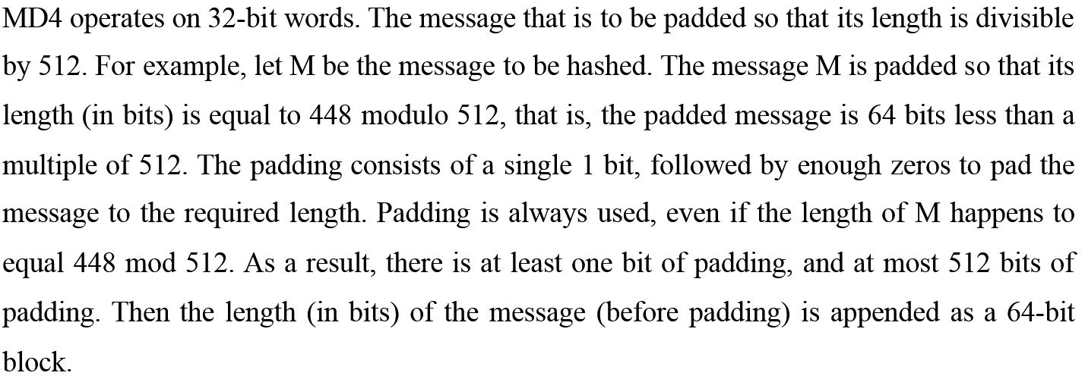
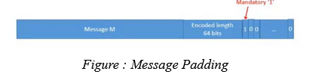
MD4
Example:

Slide 25
MD4
To get the 128-bit message digest, a compression function is operated. Where a four-word buffer (A,B,C,D) is used to compute the message digest.

Slide 26
MD5
a cryptographic hash function algorithm that takes the message as input of any length and changes it into a fixed-length message of 16 bytes.
MD5 was developed as an improvement of MD4, with advanced security purposes.
The output of MD5 (Digest size) is always 128 bits.

Slide 27
MD5 Working Algorithm
Append Padding Bits: In the first step, we add padding bits in the original message in such a way that the total length of the message is 64 bits less than the exact multiple of 512.
2. Append Length Bits: In this step, we add the length bit in the output of the first step in such a way that the total number of the bits is the perfect multiple of 512.
3. Initialize MD buffer: Here, we use the 4 buffers i.e. J, K, L, and M. The size of each buffer is 32 bits.
4. Process Each 512-bit block: Here a total of 64 operations are performed in 4 rounds. Each round with 16 operations. Different function is used in different rounds and 3 buffers is used for each function.
Output: After all, rounds have been performed, the buffer J, K, L, and M contains the MD5 output starting with the lower bit J and ending with Higher bits M.

Slide 28
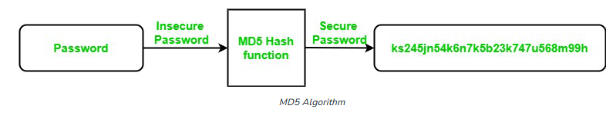
Use of MD5 Algorithm:
It is used for file authentication.
In a web application, it is used for security purposes. e.g. Secure password of users etc.
Using this algorithm, We can store our password in 128 bits format.

Slide 29
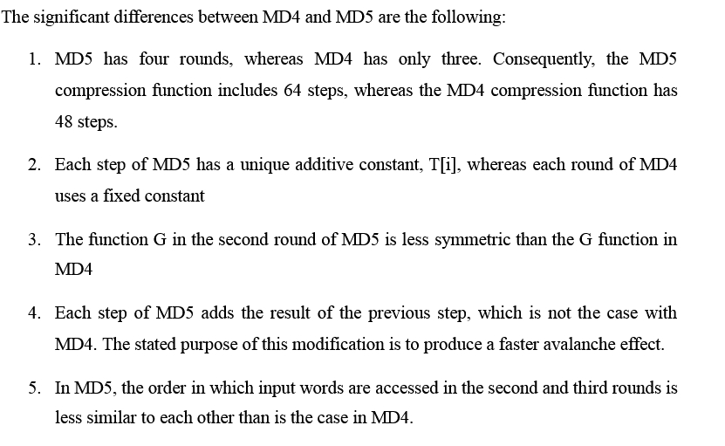
Difference between MD5 and MD4 Alogrithm:

Slide 30
3.4 Secure Hash Algorithms: SHA-1
a family of cryptographic functions designed to keep data secured. It works by transforming the data using a hash function: an algorithm that consists of bitwise operations, modular additions, and compression functions.
these algorithms are designed to be one-way functions, meaning that once they’re transformed into their respective hash values, it’s virtually impossible to transform them back into the original data.

Slide 31
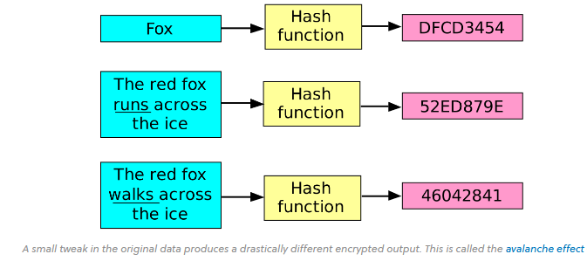
3.4 Secure Hash Algorithms SHA-1
A common application of SHA is
to encrypting passwords, as the server side only needs to keep track of a specific user’s hash value, rather than the actual password.
This is helpful in case an attacker hacks the database, as they will only find the hashed functions and not the actual passwords, so if they were to input the hashed value as a password, the hash function will convert it into another string and subsequently deny access.

Slide 32
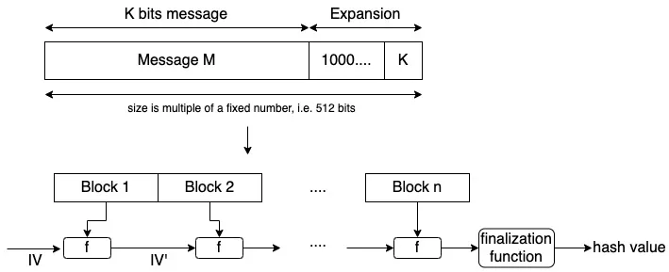
3.4 Secure Hash Algorithms SHA-1 Construction
The original message is processed in blocks. The blocks are concatenated using an initial vector (IV) and a function f.
The value of the initial vector will change with each concatenation and at the end, we obtain the hash value.

Slide 33
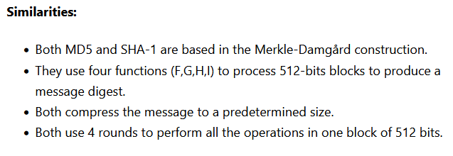
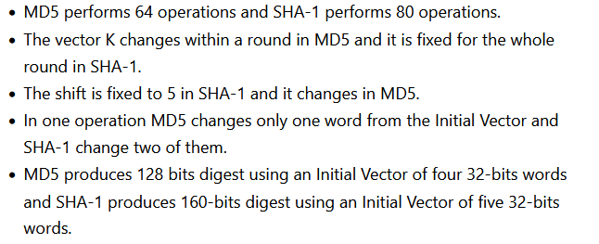
Similarities and differences between MD5 and SHA-1
Differences

Slide 34
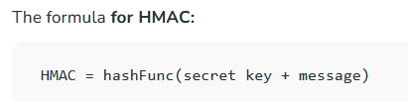
3.5 HMAC (Hash Based Message Authentication Code)
a cryptographic hash function that uses a secret key as input to the hash function along with the message being hashed. The resulting hash value is unique to the message and the secret key.
Used for both Integrity and authentication.

Slide 35
Working of HMAC:
Choose a cryptographic hash function to use for the HMAC. Common choices include SHA-1, SHA-256, and SHA-512.
Choose a secret key to use for the HMAC. The secret key should be a random, unique value that is kept secret from anyone who is not authorized to access the message.
Input the message and the secret key to the HMAC function along with the desired length of the hash output and the specific hash algorithm to be used.
The HMAC function will generate a unique hash value based on the message, the secret key, and the additional information.
The hash value can then be output by the HMAC function and used to authenticate the message.

Slide 36
HMAC Uses
to generate secure hashes for storing passwords, generating unique tokens for session management, and for other security-critical applications.
Authenticating HTTP requests : client and server
Generating secure tokens : session management
Storing password hashes : storing passwords in database
Authenticating data transmissions : SSL, SSH

Slide 37
Applications of HMAC
Can be used for IoT due to less cost.
Verification of e-mail address during activation or creation of an account.
Authentication of form data that is sent to the client browser and then submitted back.

Slide 38
3.6 Digital Signatures
a mathematical technique used to validate the authenticity and integrity of a digital document, message or software.
It's the digital equivalent of a handwritten signature or stamped seal, but it offers far more inherent security.
Can provide evidence of origin, identity and status of electronic documents, transactions or digital messages.

Slide 39
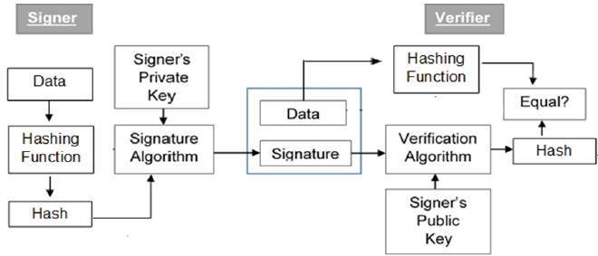
3.6 Model Digital Signatures

Slide 40
3.5 Digital Signatures Algorithms
Key Generation Algorithm : selects private key randomly from a set of possible private keys. Algorithm provides the corresponding public key.
Signing Algorithm: produces a signature for the document.
Signature Verifying Algorithm : either accepts or rejects the document’s authenticity.

Slide 41
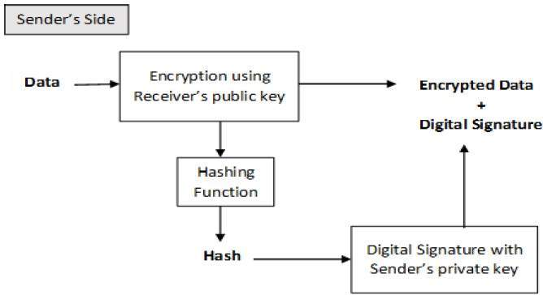
3.5 Working principle of Digital Signatures
created and verified by using public key cryptography
user who is creating the digital signature uses their own private key to encrypt the signature-related document.

Slide 42
3.5 Digital Signature Importance/Applications
Authentication
Non-repudiation
Integrity

Slide 43
Difference between HMAC and Digital Signatures
They both use cryptography keys. And they both employ hash functions. The main difference is that
digital signatures use asymmetric keys,
while HMACs use symmetric keys (no public key).

Slide 44
Assignment
Explain in detail about MD4 and MD5 algorithm.
What do you understand about HMAC ? Explain in detail.
Write shorts notes on:
a) Digital Signatures
b) SHA-1 Algorithm

